Slide 1



Introducing the sofia TeachEasy and LearnEasy software suite
Notes:
Hello, my name is Alex and I am the project manager for our company, “sofia”, and we are here to introduce to you the sofia TeachEasy and sofia LearnEasy products. These products form a software suite and will work together to enable teachers and students to further their learning outside of the classroom in an interesting and interactive way to reinforce what students learn from their teachers.

Slide 2
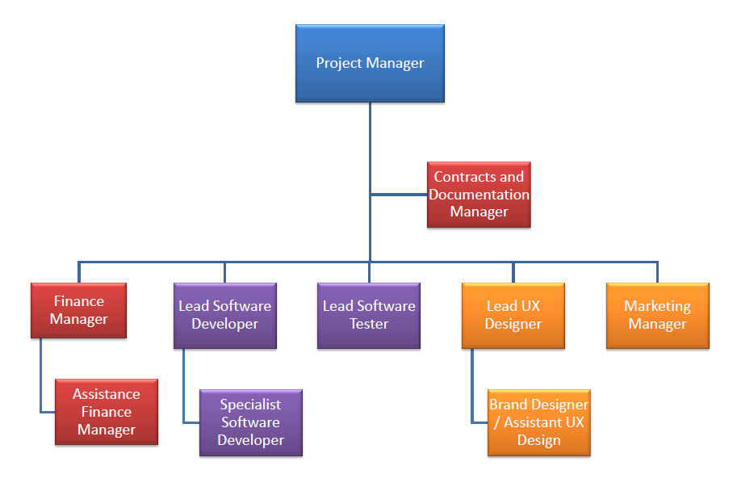
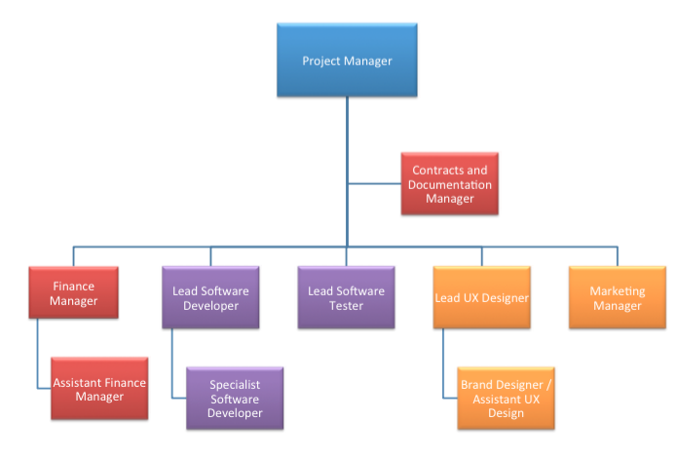
Notes:
We are a group of young and talented engineers with a broad range of skills enabling us to operate as an agile and flexible team to create great products that customers will really value. Between us we provide the managerial, financial and technical expertise to both design and implement excellent products whilst maintaining a financially viable and successful business model. Our team is made up of: Contracts and Documentation Manager: Calum
Finance Manager: Emmanuel
Assistant finance Manager: Penny
Lead Software Developer: Ali
Specialist Software Developer: Dan
Lead Software Tester: Sam R
Lead UX Designer: Sam H
Brand Designer and Assistant UX Designer: Lewis
Marketing Manager: Jake

Slide 3
s o f i a
Education
Technology
Notes:
So what do we do? Every company has a purpose, an ethos to work from. There is always some reason behind its creation. We work together, although with separate job roles, on a par with each other where each person may take leadership on any given task. It improves work flow and removes any authoritarian hierarchy that may make someone feel as if it is not ok to raise issues and problems.
sofia aims to improve the integration of technology in education with the highest quality of professional products designed for educators and educaties alike. We strive to work with our client, their ideas always at the center of our focus at all times, working in a way that allows as to constantly modify and change our solutions to best accommodate their problems.

Slide 4
Strengths
Talented employees
Good atmosphere
Good communication
Customer orientated Agile design philosophy
Experienced tutors within team
Weaknesses
Inexperienced
Start up company
Low funds
Opportunities
Gap in the market
Large market
Interested students
Threats
Low current market share
Competitors

Slide 5

Education
Teaching
Learning
Notes:
When dealing with the art of teaching, we often come across the same problem, education has always been split down the middle, Teaching vs Learning, Teachers vs pupils, Lecturers vs students. One of the hardest things to do is find a way to teach that teachers will not only enjoy themselves but believe is useful and at at the same time be engaging and enjoyable for the students. With our products teachEasy and LearnEasy we are aiming to achieve this, helping to form the bridge across the wide no mans land that currently exists between these two disciples. The point of sofia is not just to produce a product that someone will buy, but a product that they will actually find useful. sofia is a software solutions company, and there is no point solving a problem that does not need fixing.

Slide 7
Lesson
Pages
Text
Text
Element
Text
Video
Graphic
Image
Answer box
Audio
Multiple choice
Video
Text
Text
Video
Text
AB
Text
AB
Text
AB

Slide 8
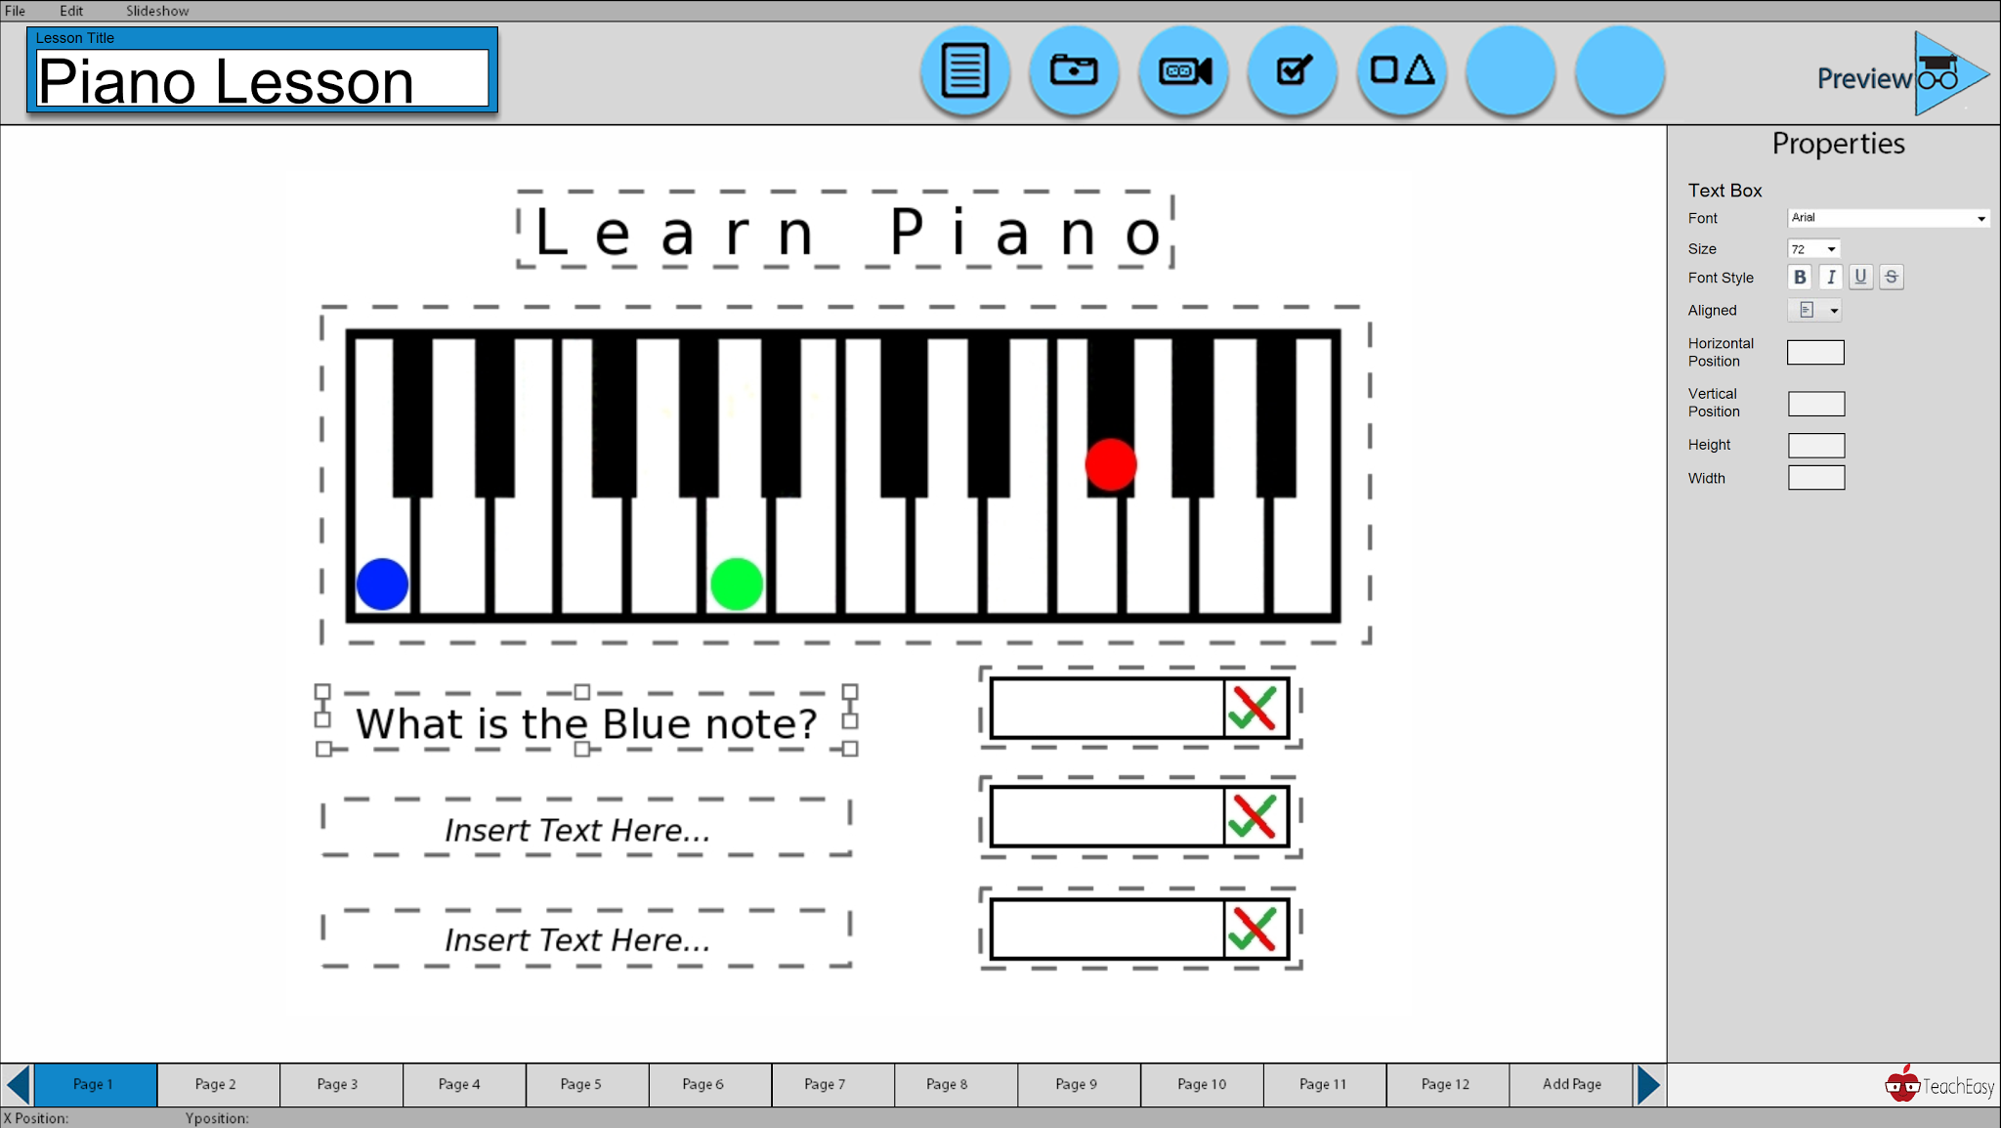
TeachEasy
Notes:
Grant access to students to use in their own time.
The teacher will be able to track the progress of the student on aspects such as marked questionnaire allowing them to access the student in a non-intrusive or stressful way. At this point lessons may be catered to specific groups of students relating to personal skill.

Slide 9
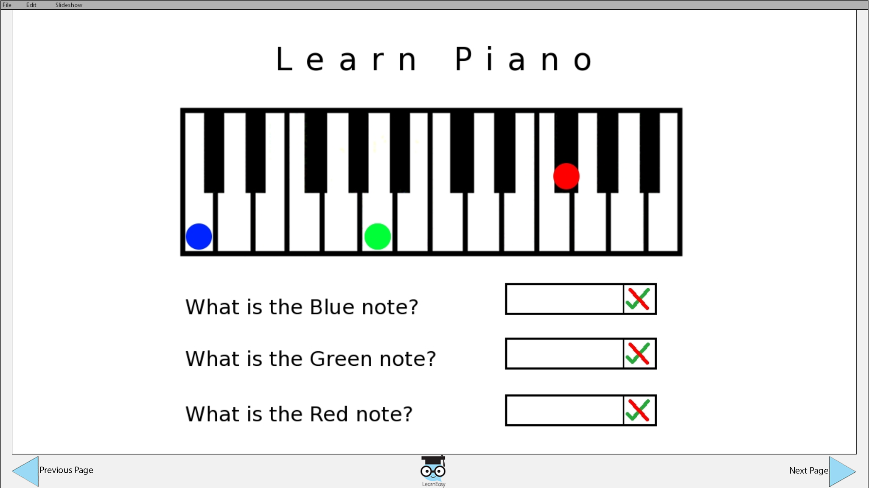
LearnEasy
Notes:
Learn easy is a way for students to complete homework in their own time in a non-stressful environment (providing that their home is a non-stressful environment and not a hellhole full of misery and spite).

Slide 10
Lesson
Student
Lesson Distributed
Student
Lesson exported
Student
Teacher
Students
Feedback via certificate
Notes:
Current

Slide 11
Future development
Teach Easy Cloud
Student
Lesson
Downloaded
Lesson
Uploaded
Student
Teacher tracks progress and achievement of students
Results logged
Student
Teacher
Students
Notes:
Future

Slide 12
Intuitive
Extend Teaching and Learning Capabilities
Reduce Paper Usage
Customisable
Notes:
Intuitive: Easy to use to to speed up teaching process. Teachers will not use a program that takes ages to workout how to use. They arlready have a fast system.
Customisable: Give the ability to provide students with catered lessons
Extend: Ability to add extra features that specific tutors/teachers find useful
Reduce trail: In a digital age there is no need for all of the wasted paper.

Slide 13
Market Research
Requirements
Product Design Philosophy
Ease of Use
Appealing
Notes:
Market research: Mention that customer is the core concept of designing our products, there needs to be a demand for a given
product before anything else. R.C.: we will use an adaptive requirements capture, in which there will be constant customer
involvment and feedback, to force the product to keep to the market and customers needs. Ease of Use: The product
needs to be simplistic so that anyone can use it and find the respective sections. Simplicity is key. Appealing: the user interface
should be aesthetically pleasing

Slide 14
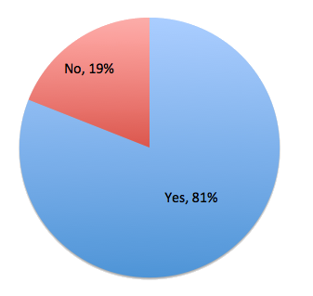
LearnEasy
Would you like to use an application like LearnEasy?
24,372 schools
438,000 teachers
8.2 million pupils
> 1 million tutors
https://www.gov.uk/government/publications/number-of-schools-teachers-and-students-in-england/number-of-schools-teachers-and-students-in-england
Notes:
From market research we know that there is a market for this type of application from a students point of view.

Slide 15
Uniform Style
Object Oriented
Software Design Philosophy
Notes:
Market research: Mention that customer is the core concept of designing our products, there needs to be a demand for a given
product before anything else. R.C.: we will use an adaptive requirements capture, in which there will be constant customer
involvment and feedback, to force the product to keep to the market and customers needs. Ease of Use: The product
needs to be simplistic so that anyone can use it and find the respective sections. Simplicity is key. Appealing: the user interface
should be aesthetically pleasing

Slide 16
Iteration loop
All requirements satisfied
Requirements
capture
Project
plan
Select
user stories
Final
product check
Design
Implement
and test
Verify
Notes:
The above diagram represents our design methodology which is based on agile. Agile is better suited than waterfall to projects which are not static, projects which may change throughout the development, projects such as ours. Instead of using ‘phases’, our design will incorporate iterations.
Requirements Capture - non technical user stories, a functional spec is derived from the analysis of the customers initial requirements.
Project Plan - is very general, unconfined. The deadline for the finished product was set but that was it. Minimal restrictions.
Iteration loop - The loop is completed once per iteration. This means that the customer can be contacted upon each completion of the loop and the latest version of the product can be shown and explained. It can be seen in the diagram that whilst in the loop
Final check - Use manual tests to ensure that the final product meets the clients initial requirements.

Slide 17
Testing
Testing
Notes:
We work iteratively so that the customer can see a working product at different stages through the development, allowing them to give suggestions etc. as required.
Do not follow TDD but test early test often
Two types of testing -
testing is completed during implementation as each feature is created
At the end of each iteration there will be a verification stage to ensure that implementing additional functionality hasn’t broken any previous functionality.

Slide 18
For education made easy peasy, meet your new best friends TEasy and LEasy
Notes:
Who are we?
Forward thinking
Agile
SYNERGY
Collaboration
Market disruption
BuzzWords

